Slide 1
Improving Demand Forecasting
A Study in Data Science by Juichia Che Holland

Slide 2
Define

Slide 3
The Problem
What is the seasonality of products in a store? How does demand compare across different stores for the same item? What about seasonally? What will the demand for a product be in the next few months? Accurate forecasting of sales and demand is an important part to managing the supply chain for both online and physical retail.
This time series study analyzes the sales of 50 different items at 10 stores in a span of 5 years and goes through a process of fine tuning the forecasts in demand.

Slide 4
The Data
The dataset comes from Kaggle’s store item demand forecasting challenge. It describes the daily sales numbers over 5 years of 50 items across 10 stores each and comes in 2 csv files, train.csv and test.csv. This analysis assumes that the stores are from the US.
 | date | store | item | sales
0 | 2013-01-01 | 1 | 1 | 13
1 | 2013-01-02 | 1 | 1 | 11
2 | 2013-01-03 | 1 | 1 | 14
3 | 2013-01-04 | 1 | 1 | 13
4 | 2013-01-05 | 1 | 1 | 10
0 - 913,000
1 - 10
per item
1 - 50
0 - 231
2013-01-01 to 2017-12-31 per item per store

Slide 5
The Process
Explore the descriptive statistics, density, distribution, trend, and seasonality of overall and individual item sales
Explore

Slide 6
The Process
Explore the descriptive statistics, density, distribution, trend, and seasonality of overall and individual item sales
Explore
Engineer
Extend the dataset with descriptive features for the dates. Determine feature importances based on predictive modeling using tree based learning algorithm.

Slide 7
The Process
Explore the descriptive statistics, density, distribution, trend, and seasonality of overall and individual item sales
Test and transform the time series for stationarity.
Explore
Engineer
Transform
Extend the dataset with descriptive features for the dates. Determine feature importances based on predictive modeling using tree based learning algorithm.

Slide 8
The Process
Explore the descriptive statistics, density, distribution, trend, and seasonality of overall and individual item sales
Test and transform the time series for stationarity.
Explore
Engineer
Transform
Model
Extend the dataset with descriptive features for the dates. Determine feature importances based on predictive modeling using tree based learning algorithm.
Forecast item sales using a variety of models. Evaluate and compare the results of prediction.

Slide 9
The Process
Explore the descriptive statistics, density, distribution, trend, and seasonality of overall and individual item sales
Fine tune the seasonal orders of the predictive models and iterate.
Test and transform the time series for stationarity.
Explore
Engineer
Transform
Model
Tune
Extend the dataset with descriptive features for the dates. Determine feature importances based on predictive modeling using tree based learning algorithm.
Forecast item sales using a variety of models. Evaluate and compare the results of prediction.

Slide 10
Explore

Slide 11
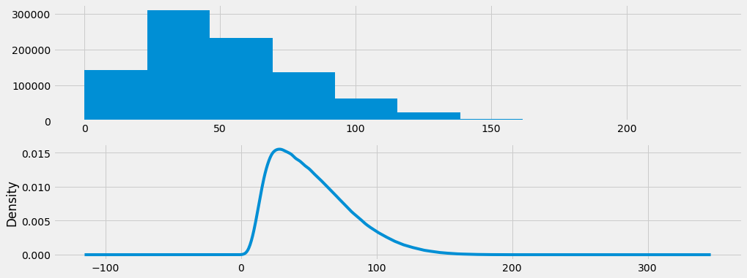
Overall Sales
52
Daily sales numbers range from 0 to 231 with a mean of 52. The majority, or middle 50%, of daily item sales numbers fall between 30 and 70, and there are the least number of observations above 100. Density of the sales observations shows the data has non-normal distribution and is slightly left shifted.

Slide 12
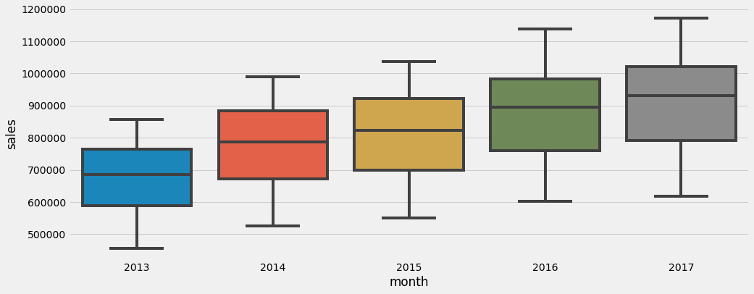
Overall Sales
Median sales values have an upward trend over time. Total annual sales volume increased slightly each year, and there is also an increase in the spread, or middle 50% of the data, over time.

Slide 13
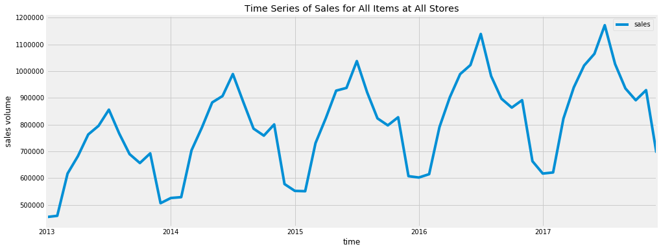
Overall Sales
Each year, total sales climbs to a peak in July from January, and then goes back down to a trough with a slight peak in November. Reviewing the total sales numbers over time for all items in all stores reveals a time series with yearly seasonality and an upwards trend.
July
November

Slide 14
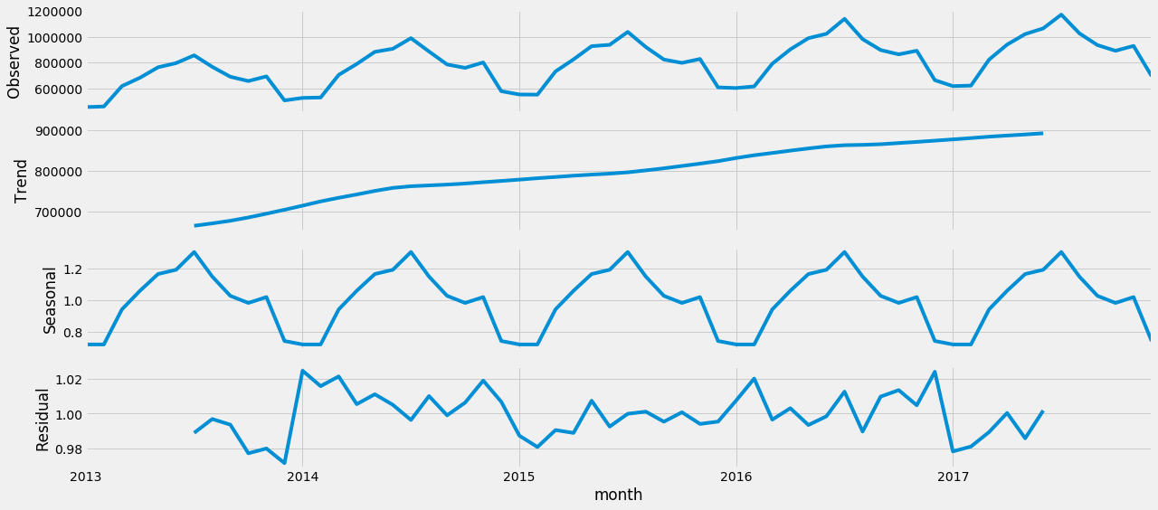
Decomposition
An upwards trend and strong seasonality are visible with decomposition of the time series for the sales totals of all items at all stores. This indicates that transformations might be required prior to modeling, and that models which take seasonality into consideration should be utilized when making forecasts.

Slide 15
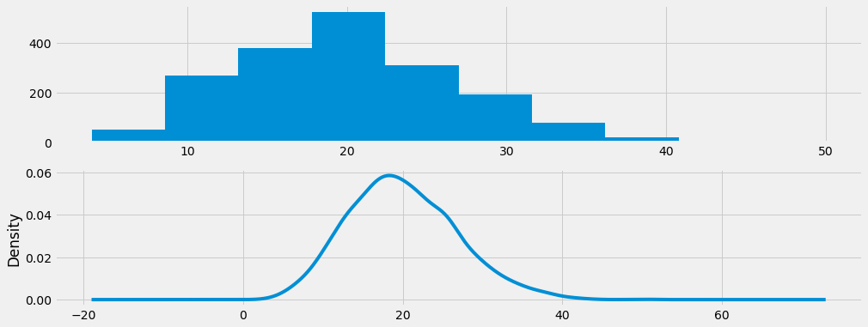
Individual Sales
20
For item 1 at store 1, daily sales numbers range from 4 to 50 with a mean of 20. The majority, or middle 50%, of daily sales numbers fall between 15 and 24, with the least number of observations below 8 and above 35. Unlike overall sales, density of individual item sales observations at one store shows the data is normally distributed.

Slide 16
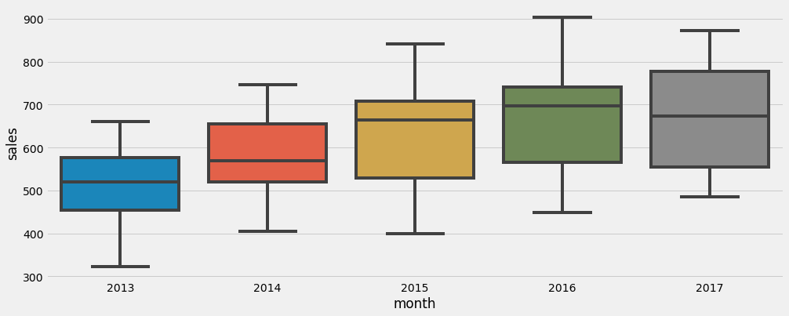
Individual Sales
Both the median and total volume of annual sales for item 1 at store 1 decreased from 2016 to 2017. There is an overall increase in the spread over time.

Slide 17
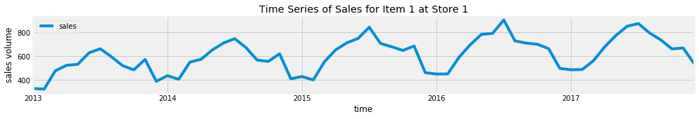
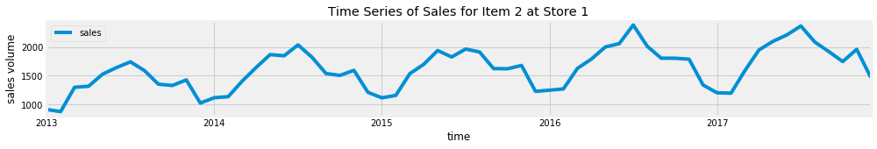
Individual Sales
For both item 1 and item 2 at store 1, the peaks and troughs are irregular throughout the years. The trends and seasonality of the time series are less pronounced.

Slide 18
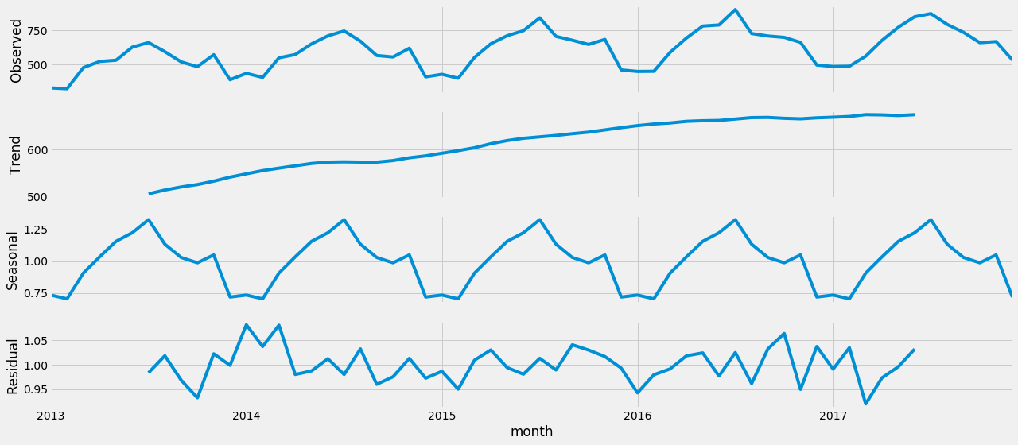
Decomposition
An upwards trend and strong seasonality became more visible with decomposition of the time series for the sales of item 1 at store 1. This indicates that transformations might be required prior to modeling, and that models which take seasonality into consideration should be utilized when making forecasts.

Slide 19
Engineer

Slide 20
Extending Date Features
date | store | item | sales | month | Year | Month | Week | Day | Dayofweek | Dayofyear | weekofyear | Is_month_end | Is_month_start | Is_quarter_end | Is_quarter_start | Is_year_end | Is_year_start
2013-01-01 | 1 | 1 | 13 | 2013-01 | 2013 | 1 | 1 | 1 | 1 | 1 | 1 | FALSE | TRUE | FALSE | TRUE | FALSE | TRUE
2013-01-02 | 1 | 1 | 11 | 2013-01 | 2013 | 1 | 1 | 2 | 2 | 2 | 1 | FALSE | FALSE | FALSE | FALSE | FALSE | FALSE
2013-01-03 | 1 | 1 | 14 | 2013-01 | 2013 | 1 | 1 | 3 | 3 | 3 | 1 | FALSE | FALSE | FALSE | FALSE | FALSE | FALSE
2013-01-04 | 1 | 1 | 13 | 2013-01 | 2013 | 1 | 1 | 4 | 4 | 4 | 1 | FALSE | FALSE | FALSE | FALSE | FALSE | FALSE
2013-01-05 | 1 | 1 | 10 | 2013-01 | 2013 | 1 | 1 | 5 | 5 | 5 | 1 | FALSE | FALSE | FALSE | FALSE | FALSE | FALSE

Slide 21
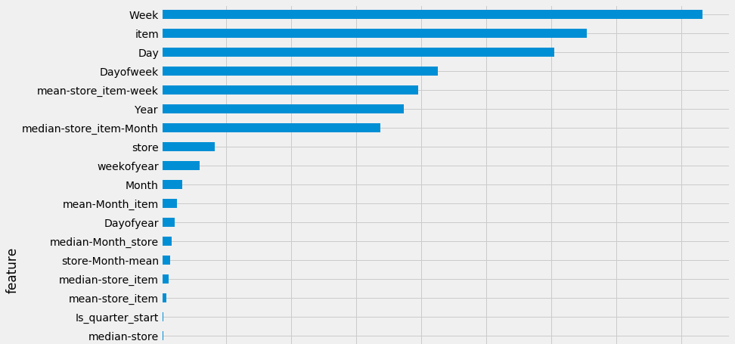
Feature Importances
Tree based learning algorithms from the LightGBM framework are used to determine feature importances.
The week, item, and day are the top 3 most important features having the biggest impact on sales numbers. Conversely, the store, day of year, and month are among the least important features

Slide 22
Transform

Slide 23
Test for Stationarity
Stationarity of an individual time series (for item 1 at store 1) is checked using the augmented Dickey-Fuller Test. Here the null hypothesis is that the time series is non-stationary.
Since the series has a strong upward trend, we will use the strictest 1% critical value to test the hypothesis. We accept the null hypothesis and the time series of item 1 at store 1 is non-stationary. Transformations of individual time series are necessary prior to modeling using ARMA models.
Results of Dickey-Fuller Test:
Test Statistic -3.157671
p-value 0.022569
#Lags Used 23.000000
Number of Observations Used 1802.000000
Critical Value (1%) -3.433984
Critical Value (5%) -2.863145
Critical Value (10%) -2.567625

Slide 24
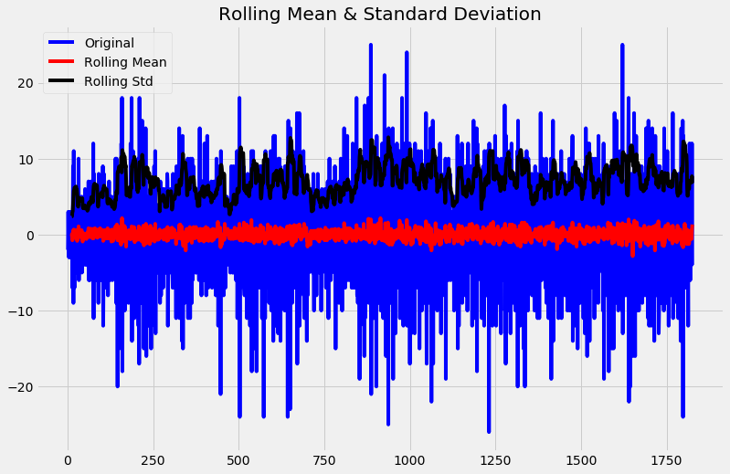
Differencing
To transform the series of sales numbers of each item at each store, we take the difference of the observation at a particular instant with that at the previous instant using first order differencing in Pandas. The transformed time series shows constant variance over time.

Slide 25
This is the most important takeaway that everyone has to remember.

Slide 26

Thanks!
juichiaholland@gmail.com
www.juichiacheholland.com

